Slide 1


01/06/2025
OS Fundamentals
What are Operating Systems?

Slide 2
Teams

Slide 3



Canopy Accord
(team canopy)
Harmonics Group
(team harmony)
Steelbound
(team steel)
Pranath Chamarthi
Sanjay Marathe
Sophia Raldugina-Zhu
Benjamin Thai
Justin Ahn
Bryan Liu
Omar Shalash
Yengkai Yang
Ryan Guan
Jason Guieb
Tara Pai
Zahi Imaduddin

Slide 4
Milestones
Join the Discord and update your nickname to your real name
Follow the VPN instructions at https://tinyurl.com/kru5aaev and verify that your connection is working.
Then follow the instructions in your team’s channel to connect to your kali machines

Slide 5
Content
1
Operating Systems?
2
Windows CLI
3
Linux CLI
4
SSH Overview
5
RDP Overview

Slide 6
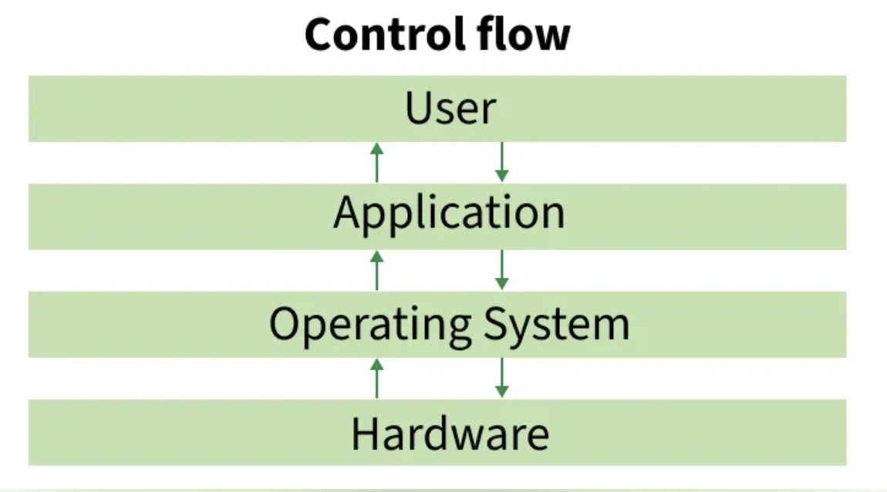
What is an Operating System (OS) ?
How you interact with your computer (MacOS, Windows, Linux)
At a fundamental level, allow users to execute programs on their computers (e.g. Chrome, VsCode)
Large share of personal computers are MacOS and Windows
Large share of servers are Linux
Notes:
An OS is a software that lies between the device’s hardware and software. It helps the user interact with the computer to handle tasks such as memory management, file systems, and input/output.

Slide 7
Aside: Servers
“Servers” are simply computers that exist to serve content or some kind of service to clients.
Whereas personal computers/workstations exist to allow individuals to run programs and interact with servers.
Openlab is a server that serves SSH (remote access) so that students can run code on it.
The school runs a Cisco AnyConnect VPN server to allow students to access internal school resources without being physically present at the school.

Slide 8
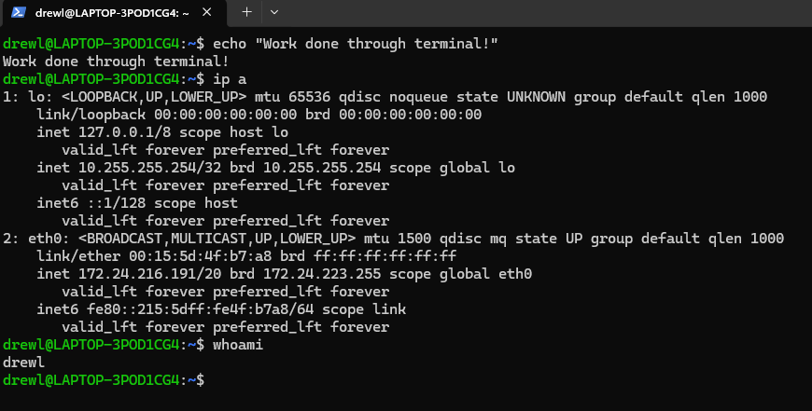
What is a Command Line Interface (CLI)?
Text based interface that allows users to interact with software/OS by typing commands into a terminal/console
CLI sessions are referred to as “shells”
You can do almost anything you can do normally on a computer with a CLI (e.g. run a program, find a file, shutdown the computer, etc.)
Notes:
Allows users to interact with the operating system using text commands. A command line interface relies on text input/output and operates through a shell. The user types a command, the shell interprets the command, executes it, and outputs to the user the corresponding text in the terminal.
Demonstration for opening vscode via GUI and terminal

Slide 9
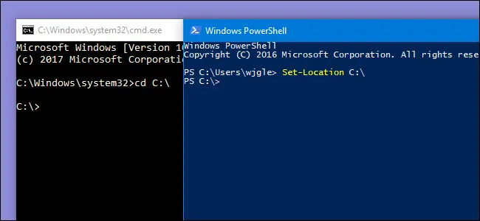
Windows CLI
Primary CLI tools (Command Prompt and Powershell)
Command Prompt (CMD) is a legacy CLI
Powershell (PS) relies on commandlets and serves as a replacement for CMD
  Has aliases for common linux commands
Common Commands:
PS: ls, cat, cd, mkdir, pwd, cp, mv, rm
CMD: dir, type, cd, pwd, copy, move, del
Networking: ipconfig, ping, arp
Notes:
The windows specific CLI consists of the command prompt and powershell which allow the user to directly interact with the OS for file management/networking. The command prompt is the older, legacy shell used when working with older scripts and to perform quick tasks. You’ll mainly use Powershell as it is more modern and the default CLI for most Windows users. We use Powershell for more complex scripting and modern tasks.

Slide 10
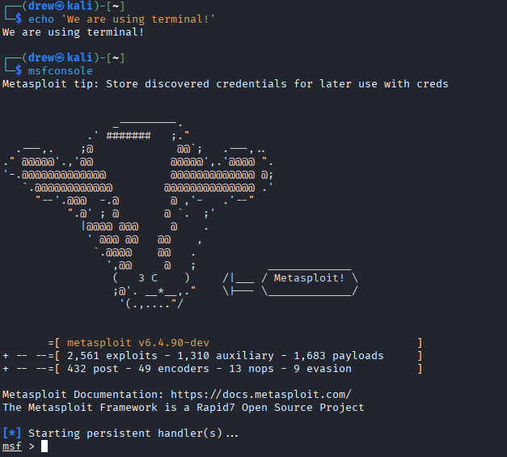
Linux CLI - Terminal
Primary CLI tools (sh, bash, zsh, fish)
Most exploitation tools come as CLI programs
Almost everything can be easily done though the terminal!
Common Commands:
Files: ls, file, cd, pwd, cp, mv, rm, nano, vim
Networking: ifconfig, ping, arp
Notes:
The linux cli is the text based method for interacting with the Linux OS. We can access the CLI in linux by typing in terminal/command/shell. Common commands include pwd which will show you the current working directory (or current location in your file system)

Slide 11
Practical usage guide
The things you’ll have to do most often across both operating systems:
Be familiar with file paths (/path/to/file or C:\path\to\file)
List files in a directory: ls and dir (or ls /path/to/directory/)
Switch to a specific directory: cd /path/to/directory
Display file content (not for non-text files like PDFs or ZIP): cat /path/to/file
Show IP address information: ifconfig or ipconfig
Edit a file within the CLI (only natively supported on linux): nano /path/to/file or vim /path/to/file
  Open a notepad for a file on Windows: notepad.exe /path/to/file
Notes:
Complete each of these actions on both a windows and linux machine

Slide 12
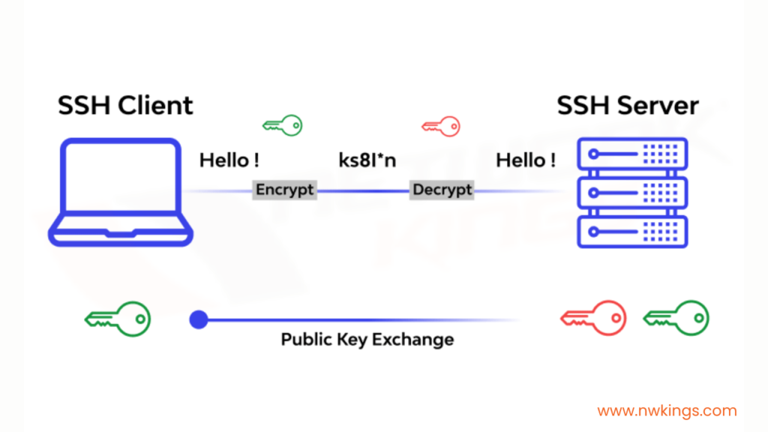
SSH
What Does SSH Mean?
Secure Shell protocol
Allows you to remotely connect to a machine through a terminal
Protocol optimized for Linux server access, but still supported on Windows.
Highly secure
Main Components:
Remote encrypted connections
Ability to tunnel
Authentication
Notes:
Reference SSH stands for secure shell protocol and is a method for sending commands to a computer over a network. SSH works on a client-server model and operates on TCP port 22. It sets up a connection between a user’s device (client) and a remote computer (server) while protecting messages from outside listeners with encryption. When another party tries to intercept, they would see only random data. It also has the ability to tunnel (moving packets across a network). SSH also uses use public key cryptographicy to verify the identity of server and the user (makes it more secure than traditional passwords)

Slide 13

SSH Example
ssh username@hostname
Ex: connect to account on remote server superuser with ip address 10.100.55.100
ssh superuser@10.100.55.100
Note: Password appears blank when typing
Tip: Try using the -v flag to see what happens under the hood
You are now connected!

Slide 14
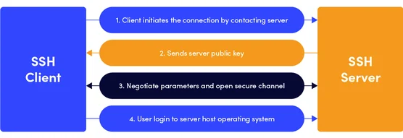
How does SSH work?
Client (computer connecting from)/server (computer connecting to) authentication model
Server listens on TCP port 22
Notes:
Server listens on TCP port 22 by default Runs with TCP/IP Protocol

Slide 15
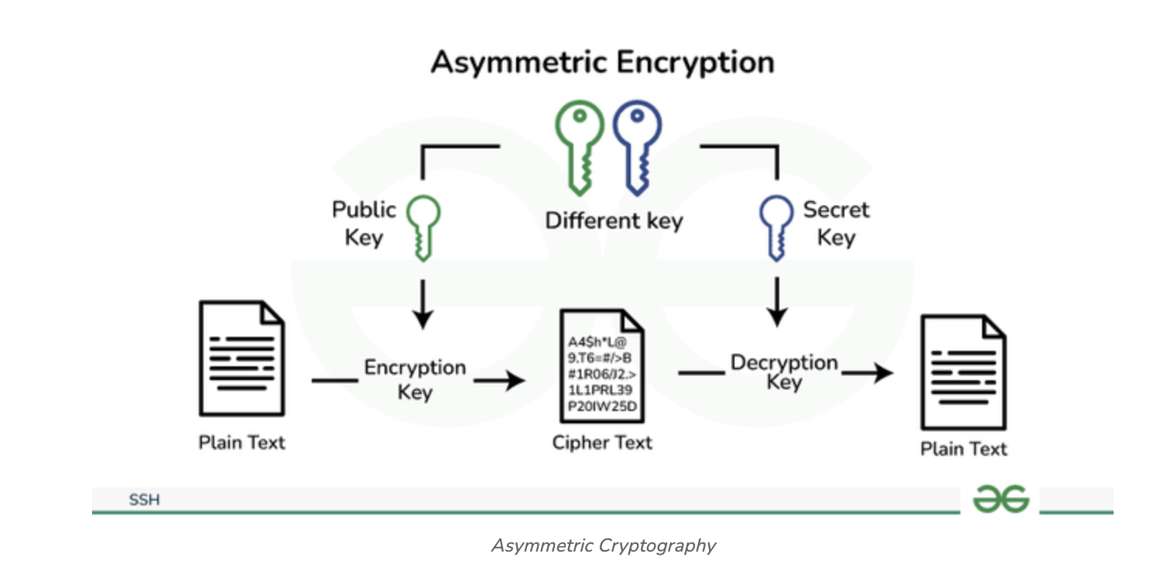
SSH Key Encryption
Use passwords or public/private keys (public key is the lock and private key is unique key to access it)
  Public key and private key are both required for authentication
  Normal to release public key, very bad to release private key
  Keys stored in ~/.ssh/ (~ is user home directory)
Notes:
SSH uses public key cryptography for authentication where there is both a public key and private key. The public key is like a lock and the private key is like a unique key that opens the lock. It is completely normal to share the public key, but very dangerous to share privaete key. The public key is stored on the server while private key is secret and stored on the user’s local machine.
How SSH authentication works:
The server will create a message and use the public key to encrypt a message and send it to the client. The client will then decrypt the message with their private key and sends the message back to the server. If server verifies the response, then authentication succeeded.

Slide 16
SSH Misconfigurations
Vulnerabilities
Attackers can steal SSH keys in order to access private computers/server
  Someone else having your private key allows for them to authenticate as you
Misconfigured SSH settings (/etc/ssh/sshd_config)
  Root login enabled (PermitRootLogin)
  Empty passwords permitted (PermitEmptyPasswords)
Poor password
  Servers on the open internet are constantly and continually brute forced by various bots
Notes:
Show SSHd configuration file
Weak or default configurations increase potential for attacks. For example, root login enabled allows attackers to directly target the most powerful account (root). Empty passwords allows attackers to login with blank passwords. Poor passwords are easily cracked by automated tools or bots.

Slide 17

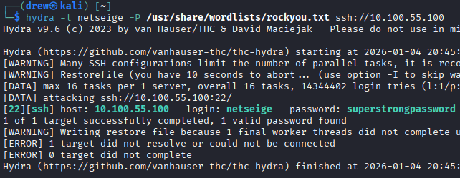
Brute Forcing - Hydra
Weak passwords can easily be guessed
Hydra allows for easy brute forcing
  Be careful many systems have lock out after a number of failed logins
Syntax:
hydra -l [user] -P [password_list] ssh://[ip]
Capital L/P specifies wordlist
Lower l/p for set user/password
  /usr/share/wordlist/rockyou.txt
Defense:
Fail2Ban - IP ban after repeated failed login attempts
Strong password use
Notes:
Reference: https://www.encryptionconsulting.com/ssh-vulnerabilities-how-to-protect/

Slide 18
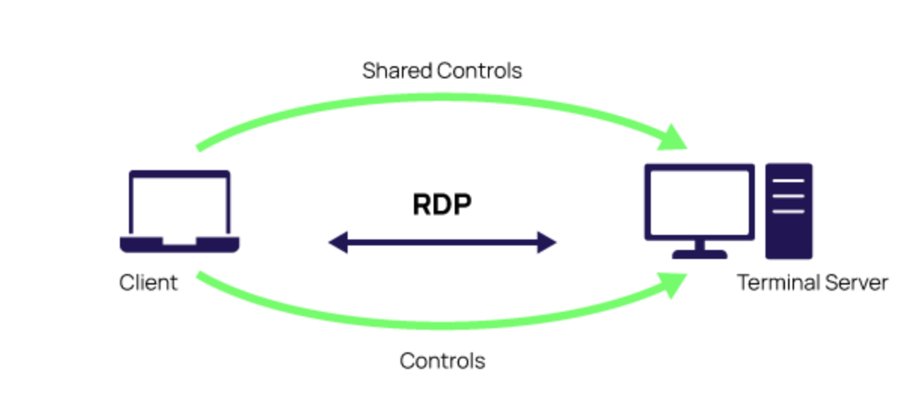
RDP
What Does RDP Mean?
Remote desktop protocol
The “canonical” method to remotely access Windows machines
Lets you view/control another physical computer remotely over a network (ex: remote employees accessing their work computers at home) with a GUI
Opens network to send data between two machines (remote desktop & computer in control) over port 3389
Notes:
Reference: https://www.cloudflare.com/learning/access-management/what-is-the-remote-desktop-protocol/
Shown in the previous lecture…
RDP allows you to view/control another computer over network as if you’re sitting in front of it! Used for working at home or for IT support.

Slide 19
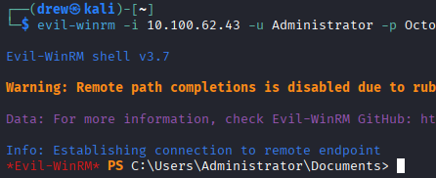
WinRM
What Does WinRM Mean?
Windows Remote Management
Similar to SSH, provides remote management of Windows systems through a terminal
Data is sent over HTTP or HTTPS
Can be used by Administrators or any user in the “Remote Management Users” group
Ex: evil-winrm -i [ip] -u [user] -p [password]
Advanced: evil-winrm -i [ip] -u [user] -H [hash]
More on this later!

Slide 20
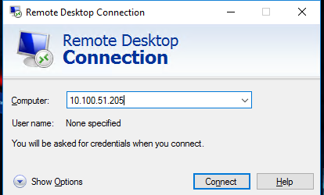
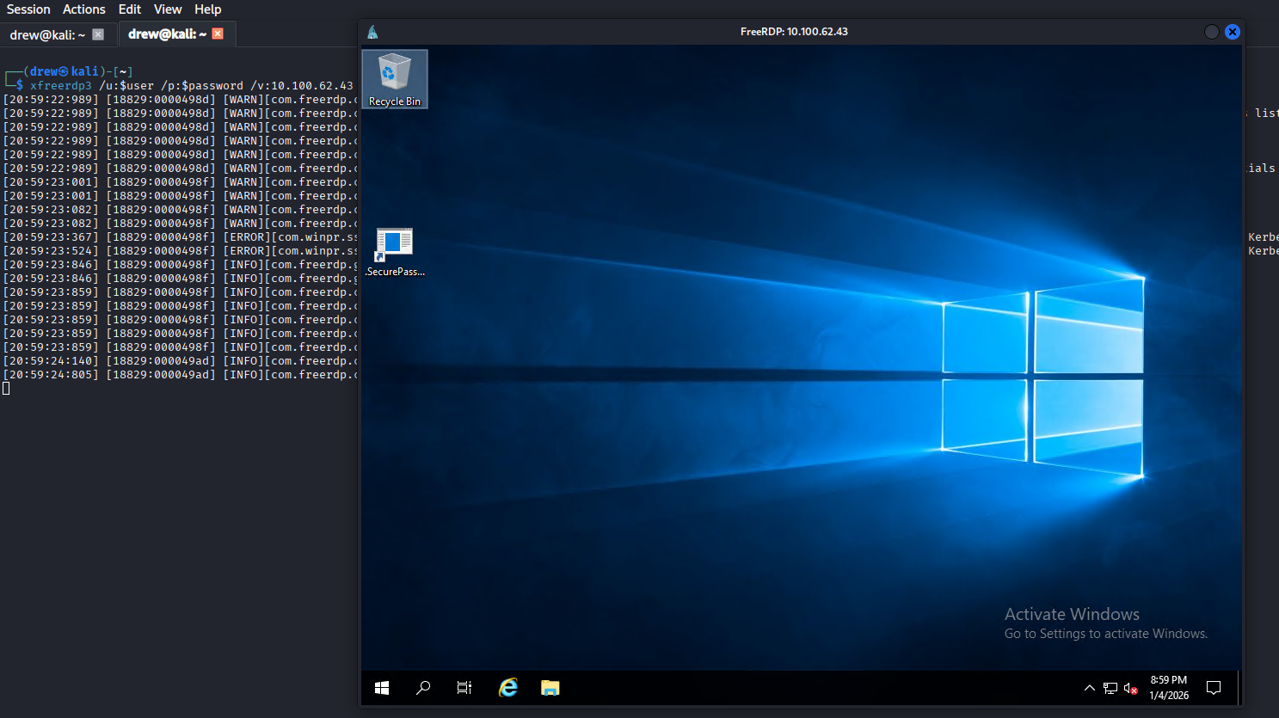
RDP In Practice
Linux: xfreerdp3
Windows: Remote Desktop Connection
Usage: xfreerdp3 /u:[user] /p:[password] /v:[ip]
Helpful flags:
  /f - full screen
  + clipboard - copy/paste
Build in windows application for remote desktop connection
GUI interface
Still requires user and password
Notes:
Reference: https://www.cloudflare.com/learning/access-management/rdp-security-risks/
https://security.berkeley.edu/education-awareness/securing-remote-desktop-rdp-system-administrators

Slide 21
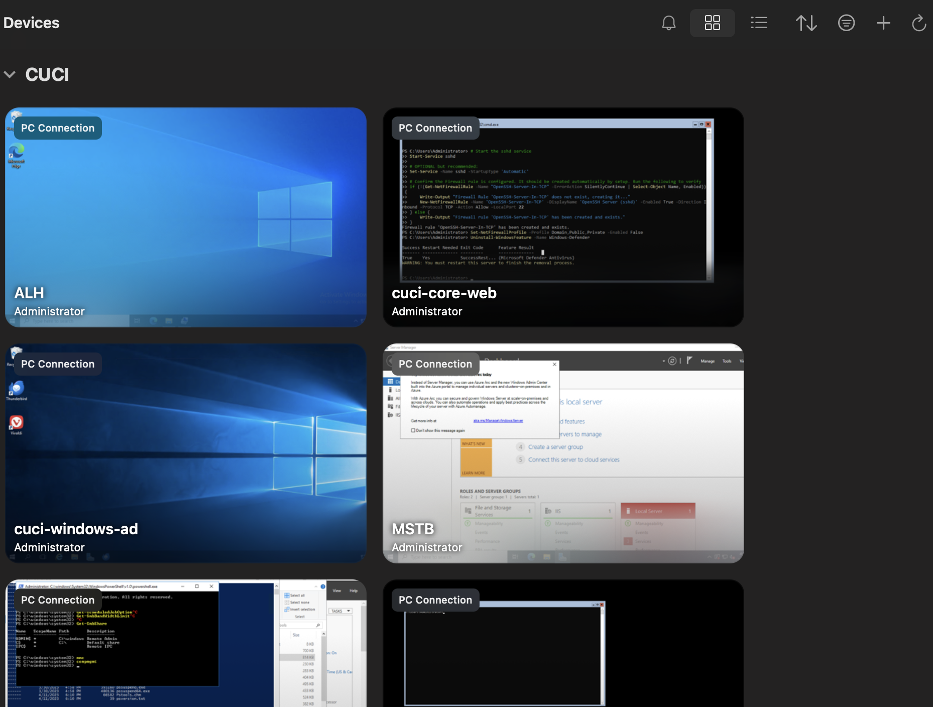
RDP In Practice
MacOS: Windows App
Windows: Remote Desktop Connection
Usage: “add pc” → fill in appropriate information such as IP, username, and password.
Build in windows application for remote desktop connection
GUI interface
Still requires user and password
Notes:
Reference: https://www.cloudflare.com/learning/access-management/rdp-security-risks/
https://security.berkeley.edu/education-awareness/securing-remote-desktop-rdp-system-administrators

Slide 22
RDP Vulnerabilities & Best Practices
Vulnerabilities
Best Practices
Attackers gain control due to weak user sign-in credentials
Gives attackers the ability to connect remotely to Windows workstations and servers
Low privileged users with RDP access
Limit users who are administrators or in the “Remote Desktop Users” group
Use strong passwords
Enable account lockout policy to prevent brute force (don’t lock yourself out!)
Notes:
Reference: https://www.cloudflare.com/learning/access-management/rdp-security-risks/
https://security.berkeley.edu/education-awareness/securing-remote-desktop-rdp-system-administrators

Slide 23
Practices to prevent RDP security Issues
Enable network level authentication
Limit who can use RDP
Using 2FA
Use strong passwords
Restrict access with firewalls

Slide 24
Resources
Security Risks of RDP

Slide 25
Questions?

Slide 26

Thank You!

